Slide 1
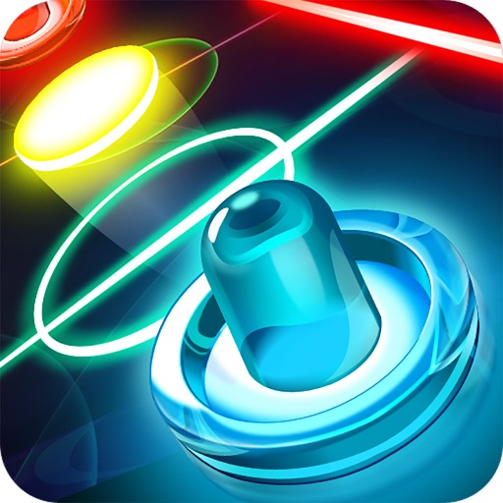
AERO BLITZ
Feel the Rush, Master the blast

Slide 2
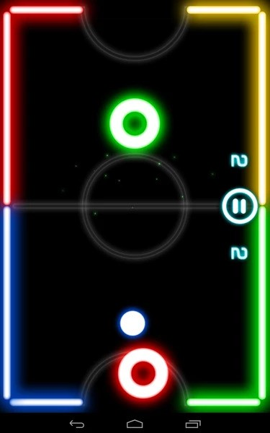
AEROBLITZ
An offline air hockey game to recreate the excitement of air hockey in a digital format.
Page 01

Slide 3
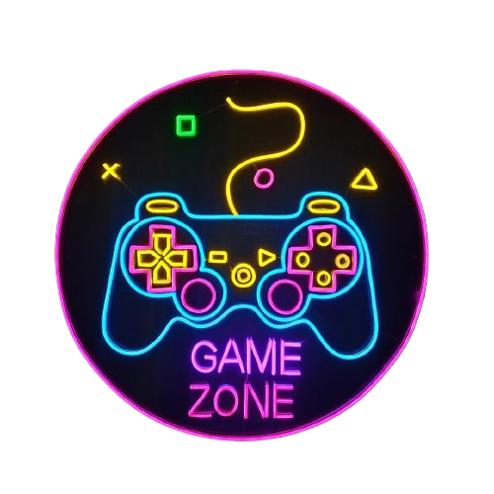
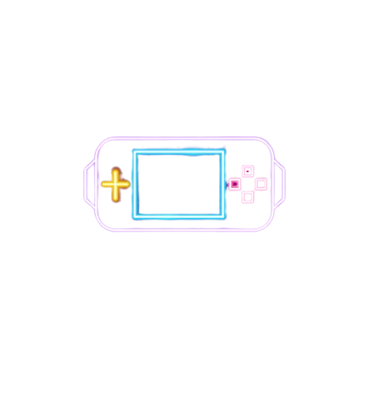
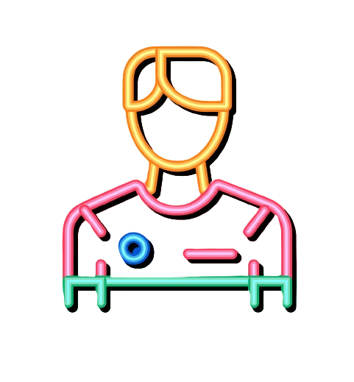
GOALS & OBJECTIVES
Developing a standalone offline air-hockey game
Seamless Gameplay Experience and High User Satisfaction
Immerse Gameplay Environment
Page 02

Slide 4



Innovative Features
Time Dilation
Power ups
Goalpost Barrier Placement
Opponent Freeze Ability
Page 03

Slide 5
Differentiation
Features
AeroBlitz
Other Air Hockey Games
Gameplay Experience
Polished and responsive gameplay with smooth puck and paddle movements
Gameplay may vary in responsiveness and smoothness
Customization Option
Extensive options for paddle designs, arena layouts, and game rules
Limited customization features, providing a less personalized experience
Immersion
Enhancement
Dynamic visual and sound effects for enhanced immersion
Visual and sound effects may be static or minimal, reducing immersion
Offline Optimization
Optimized for offline play, enabling enjoyment anytime, anywhere
Dependency on internet connection for gameplay, restricting accessibility
Page 04

Slide 6

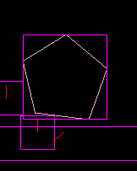



Technical Tools
01
02
03
04
05
Programming Language
Graphics Library
Physics Engine
JAVA
JAVAFX
BOX2D
IDE
Version Control
IntelliJ IDEA
GIT
Page 05

Slide 7
Timeline
Research and Requirement Analysis
Designing Game Mechanics and UI
Implementing Core Gameplay Features
Integrating Opponent Mechanisms and Local Multiplayer
Frontend and Backend Development
Testing and Debugging
Presentation and Submission
Deployment
Page 06

Slide 8
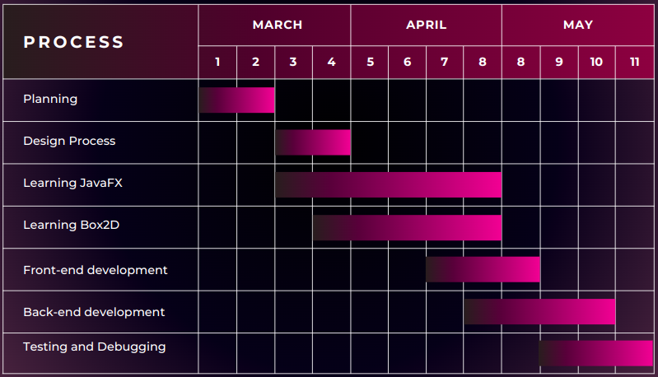

Gantt Chart
9 10 11 12
Page 07

Slide 9
TEAM KICHU EKTA BANABO
Rihila Sumayya
210041110
Fateen Noor Rafee
210041120
Nowshin Mahjabin
210041128
Page 08

Slide 10
THANK YOU

